Slide 1
Ο θεσμός των EU Careers στην Ελλάδα και οι προοπτικές απασχόλησης στα θεσμικά όργανα της Ε.Ε.
EU Careers AUTH - Ευρωπαική Υπηρεσία Επιλογής Προσωπικού

Slide 2
Τι είναι τα EU Careers;
Φορέας ενημέρωσης φοιτητών και αποφοίτων για τις θέσεις εργασίας και πρακτικής άσκησης στα όργανα της Ευρωπαϊκής Ένωσης καθώς και τις διαδικασίες επιλογής υποψηφίων.
Πρόγραμμα της EPSO από το 2010
Μοναδική ευκαιρία ενασχόλησης με το ευρωπαϊκό γίγνεσθαι

Slide 3
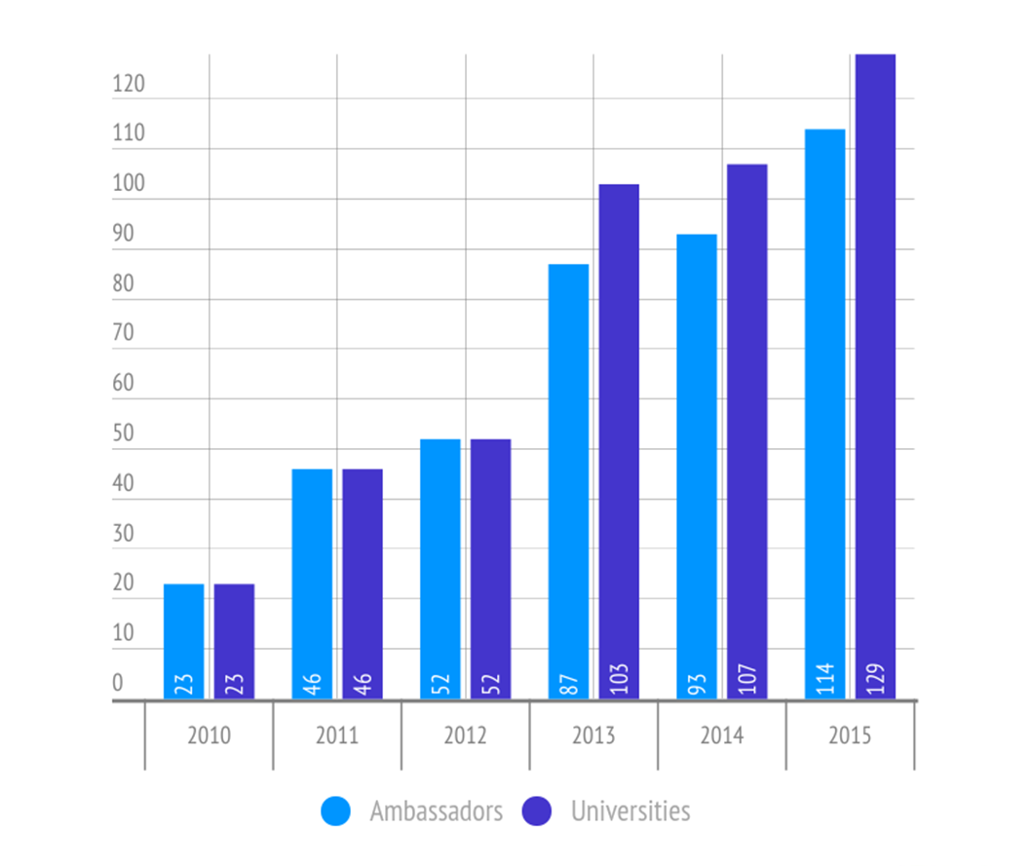
Background

Slide 4
Δράσεις
Εναρκτήρια Ημερίδα
Institutional Visit – Brussels
Free Market Road Show Thessaloniki 2016
Career Visits
Job Fair AUTH 2016
Athens Drink & Meet
EU Careers AUTH Magazine
EU Jobs & Mobility Roadshow
December Drink & Meet
Feb training on EPSO Competitions

Slide 5
Που;
Notes:
Council, Parliament, European Commission, Commitee of the Regions, Economic and Social Commitee, External Action Service, Ombudsman, Court of Justice, Court of Auditors,
Data Protection Supervisor [10 institutions EPSO selects for]
+ many agencies of the EU (such as….)
80% of jobs are in Brussels or Luxembourg
+ 20% in the EU and the World.

Slide 6
Where can an EU career lead?
Latvia
Malta
Luxembourg
Spain
United Kingdom
Denmark
Slovenia
Austria
Germany
Latvia
Germany
Lithuania
Ireland
Hungary
Ireland
Belgium
The Netherlands
Belgium
Poland
Sweden
Portugal
Hungary
Poland
Latvia
Austria
Europe
Greece
France
Finland
Sweden
Denmark
Austria
Czech Republic
Malta
The Netherlands
Greece
Latvia
Greece
Czech Republic
Poland
Ireland
United Kingdom
Spain
Denmark
Hungary
The Netherlands
Spain
Luxembourg
Estonia
Malta
France
Portugal
Poland
Slovenia
Belgium
Sweden
Italy
Italy
Slovenia
Czech Republic
Slovenia
Germany
Finland
Austria
Italy
Sweden
United Kingdom
Notes:
Other agencies and locations, examples:
Europäische Umweltagentur (EEA) in Kopenhagen, DEN
Europäische Stelle zur Beobachtung von Rassismus und Fremdenfeindlichkeit (EUMC) in Wien, AUS
Europäisches Polizeiamt (EUROPOL) in Den Haag, NDL
Institut der Europäischen Union für Sicherheitsstudien (EUISS) in Paris, Frau
Agentur der Europäischen Union für Grundrechte (FRA) in Wien, AUS
Europäisches Institut für Gleichstellungsfragen (EIGE) in Vilnius, LIT
Europäisches Unterstützungsbüro für Asylfragen (EASO) in Valletta, MAL
Europäische Agentur für Netz- und Informationssicherheit (ENISA) in Iraklio, GRE

Slide 7
Who?

Slide 8
Profiles?
European
Public
Administration
Translation
External Relations
Communication
Audit
Law
Lawyer-linguist
Interpreters
Economists
Assistants
Many
other
profiles
Proofreaders
Notes:
Mentioning different profiles & fields
Graduate /non graduate positions
Possibility to add on slides – with profiles (format of 1 slide per profile – using some pictures / standard job description / quotes – used in previous competitions)

Slide 9
Ποιόν αφορά;

Slide 10
Θέσεις Μόνιμης Απασχόλησης Vs. Θέσεις Πρακτικής Άσκησης
Μόνιμος Υπάλληλος (EU Official): Πολλά στάδια, Συνέντευξη και Λίστα
Πρακτική άσκηση: Ηλεκτρονική αίτηση, ενδεχόμενη Συνέντευξη

Slide 11
How?

Slide 12
Overview
Before you apply:
Self selection test
+
Self evaluation test
Generalist competition
Stage 1 —Preselection tests
Stage 2 — Intermediary test
Stage 3 — Assessment centre
List of successful candidates
Notes:
This is a simplified diagram of the structure of a competition, which does not reflect all possible variations for different types of competitions.
Online registration – by taking self-selection and self assessment tests + filling out the application form -→ reserve some time to do this (these tests can take up to 2 hours, for the application form you need additional time)
You will be asked to book a CBT test appointment later on - (via EU Careers website and EPSO Account)
Sitting pre-selection tests - computer-based admission tests (may not apply for specialist competitions) – details of types of tests on later slides.
The candidates who achieve the best marks in the pre-selection tests are invited to attend the intermediairy test in a test centre in Europe.
The candidates who achieve the best marks in the intermediary tests are invited to attend an assessment centre in Brussels – details on later slides.
The candidates who achieve the highest aggregate marks at the assessment centre will be included on a reserve list (subject to proof that they meet all the eligibility requirements) and are then available for recruitment by an institutiton).
Entry by open competition: Notice of Competition published in Official Journal of European Union, also available via www.eu-careers.eu
Single point of entry: European Personnel Selection Office (EPSO) - Apply online at: www.eu-careers.eu
Organised in annual cycles for general profiles
The European institutions select future officials through open competitions, which involve a series of competitive examinations.
Competitions are open to all citizens of the European Union who meet the specified requirements. This procedure gives all candidates a fair chance to demonstrate their abilities and guarantees selection based on merit while observing the principle of equal treatment.
A Notice of Competition (24 languages) setting out the requirements for each competition is published in the Official Journal of the European Union and can be accessed via the EU Careers website. Online registration to competitions is via the same website (in English, French or German).
A selection board is appointed to select the best candidates in the light of the requirements set out in the competition notice. The board compares the candidates’ performance in order to assess their suitability for the duties described in the notice. Its task is not only to evaluate their knowledge but also to identify those who are best qualified in terms of merit.
Competitions are organised:
- either in annual cycles;
- or to meet specific needs of the institutions.
More on the annual cycles of competitions on a later slide.
Candidates who pass a competition are placed on a reserve list from which the institutions draw recruits as and when they need them. The aim of a competition, then, is not to fill a specific post, but to constitute a reserve pool for recruitment.
The European Personnel Selection Office (EPSO) is the interinstitutional office responsible for organising competitions .
Two-stage procedure:
Selection
Recruitment
EPSO is responsible for the selection procedure.
The Institutions are responsible for recruitment.
For the process, procedures and scoring of all tests, you can find all details per test in the Notice of Competition.

Slide 14
Stage 1 – Preselection Computer Based Tests across Europe
Stage 1 – Preselection
Computer Based Tests

Slide 15
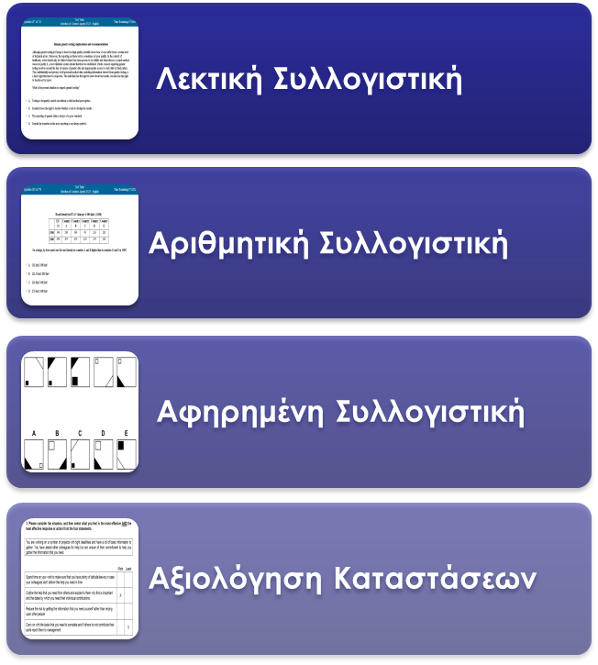
Computer Based Tests (CBT)
Στην Μητρική σου γλώσσα
1 of 24 official
EU languages
Στην ξένη γλώσσα προτίμησής σου

Slide 16
Παραδείγματα

Slide 19
Example situational judgement
X
X

Slide 20
E-tray exercise across Europe
Stage 2 – Intermediary test
Stage 2 –
Intermediary test
E-tray exercise

Slide 21
E-tray exercise
When are you invited?
E-tray exercise
If you pass all pre-selection tests +
have one of the highest total scores in: verbal + abstract reasoning
15 to 20 questions
Assessing:
Analysis and Problem solving
Delivering quality and results
Prioritising and organising
Working with others
Approximately 15 times the number of succesful candidates sought will be invited for this stage.
In Language 2

Slide 22
Example E-tray exercise

Slide 23
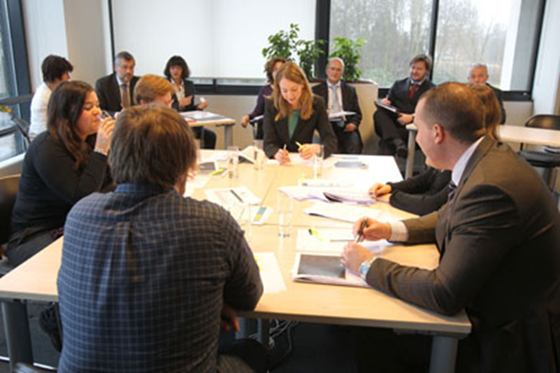
Stage 3 – Assessment Centre in Brussels (or Luxembourg)
Stage 3 –
Assessment Centre
Notes:
Under the new competition procedures, EPSO uses a standard « assessment centre » model, based on competencies. This model has been chosen by the institutions to be able to identify the most suitable and competent candidates for the profile required. After the admission tests, candidates are invited to an assessment centre session, which is normally held in Brussels.
In the assessment centre, candidates will be tested by appropriate instruments. A detailed explanation of these items will be given in the « Assessment Centre » brochure that candidates will receive when invited to take part in this stage of the procedure. The competition notice lists the items used for a particular competition.

Slide 24
Assessment Centre Testing 8 competencies
Analysis & problem solving
Resilience
Potential to lead
Prioritising & organising
Communication
Learning & Development
Delivering quality & results
Working with others
Notes:
For a full overview on these competencies and how they are tested, see the Guide to Open Competitions and the notice of competition for the competition you apply for.
It will be published on our website.

Slide 25
Assessment Centre
When are you invited?
Assessment centre
If you scored one of the highest total marks for the e-tray exercise
+
You meet the eligibility requirements according to the data in your application file
Case study
Group exercise
Structured interview
Oral presentation
Approximately 2 times the number of succesful candidates sought will be invited for this stage.
In Language 2

Slide 26
Successful Candidate
List of
Successful candidates
Contact with
EU institutions
Recruitment by EU institution
Job
Interview
Notes:
Following the competition, the selection board draws up a reserve list containing the names of successful candidates.
The list is then sent to the institutions, since responsibility for recruitment rests solely with them.
They will also be sent a document known as a “competency passport” setting out your performance at the assessment centre, which they may use during the recruitment procedure and with a view to your career development.
If your name is included on the list of successful candidates, you may be invited by an institution for an interview, but this does not mean you have any right to or guarantee of recruitment.
Under the Staff Regulations, recruitment depends on posts and funds becoming available.
Recruitment will be at the grade indicated in the competition notice.
Reserve list = Data base of successful candidates, Valid for at least 1 year – may be extended. Being on it is no guarantee for a job
Institution has a vacancy: - Checks reserve list, - Invites candidates to interview , Job offer to ‘best fit ‘
Candidate accepts offer, or remains on reserve list

Slide 27
When?

Slide 28
When to apply?
Spring
Graduates – Generalists

Slide 29
When to apply?
Summer
Linguists
Translators
Conference interpreters

Slide 30
When to apply?
Winter
Non- graduates
with experience
(Assistants)

Slide 32
What about… Bulgarian applicants?

Slide 33
www.eu-careers.eu
Notes:
You will find more information and the latest news regarding competitions on the EU Careers website. The Discover EU careers section has information in 23 languages, the other two sections are in English, French and German.
For full overview of upcoming selection procedures visit our website - http://europa.eu/epso/doc/epso_planning_en.pdf
On our facebook page… you can find…also our raconteurs, blogging about their work at the EU institutions. Contextual information - (photo's, videos)
Computer Based Tests (CBT)
http://europa.eu/epso/discover/prepa_test/sample_test/index_en.htm
Does your country provide support for your potential EU Career?
http://europa.eu/epso/discover/prepa_test/disclamer/preparatory_en.htm
Variety of Traineeships (also languages, sciences) : http://ec.europa.eu/stages/index_en.htm
Temporary Vacancies: http://europa.eu/epso/apply/today/temporary_en.htm
Other: http://europa.eu/youreurope/citizens/work/job-search/index_en.htm

Slide 34
Stay in touch!
Lamprini Koletsi
EU Careers Student Ambassador Thessaloniki
eucareers.auth@gmail.com
Facebook: www.facebook.com/eucareersauth
Instagram: eucareers.auth
Further Information: www.eu-careers.eu

